Slide 1

STAT 639 Project
Group 11
Group Members:
Vasu Verma (933004913)
Sumeet Nazare (131005188)
Raj Panthesh Bhavsar (933005059)
Course Instructor:
Prof. Yang Ni

Slide 2
Presentation Outline
Supervised Learning
(Binary Classification)
Unsupervised Learning
(Clustering)

Slide 3
Binary Classification
Dataset with 500 predictors, 1 dependent variable and 400 samples.
Goal: To find the best classifier with the smallest estimate testing error.
We kept 80% of the dataset for training the models and kept the remaining 20% to estimate the test error => train_index = sample(1:nrow(Rdata),320)

Slide 4
Classifiers Used
Multiple classifiers used, including some not covered in the course.
Logistic Regression
LDA
SVM
Neural Net
PCA + Random Forest
Boruta + XgBoost.
Methods | Test Error Estimate
Logistic Regression | 0.500
LDA | 0.475
SVM | 0.525
Neural Net | 0.4375
PCA + Random Forest | 0.375
Boruta + XgBoost | 0.225

Slide 5
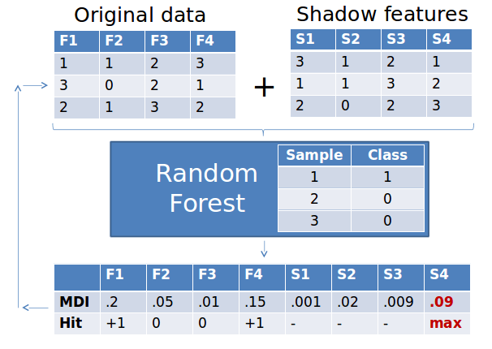
Best Classifier
Boruta + XgBoost identified as the best classifier with the smallest testing error.
Boruta is a feature selection technique that is used to identify the most important input variables for a classification problem.
It works by comparing the importance of each variable to the importance of random shadow variables.
Using Boruta we identified 21 most important variables and used them in training XgBoost.

Slide 6
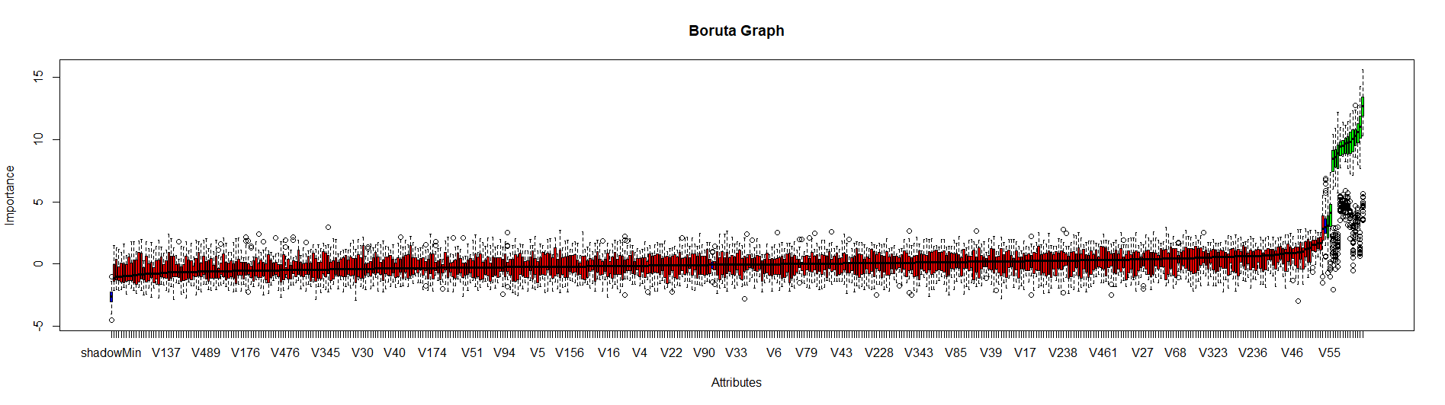
Best Classifier : Boruta Feature Selection Plot

Slide 7
Best Classifier : Description
XGBoost (eXtreme Gradient Boosting) is an ensemble learning method that combines multiple weak learners (typically decision trees) to create a strong learner.
It works by iteratively improving the prediction accuracy of the model by minimizing a loss function, such as mean squared error or cross-entropy.
It does this by adding decision trees to the model in a sequential manner, with each new tree attempting to correct the errors made by the previous trees.
We used cross validation to select best parameters the model.
Then using those best parameters trained in on the training dataset.
We were able to achieve an accuracy of 77.5%

Slide 8
Best Classifier : Flow Map
Training Data Subset
Boruta Feature Selection
Choosing / Updating Parameters
Estimate Test Error
Final Model Training Using Best Parameters
Finding min log loss using 5 Fold CV

Slide 9
Unsupervised Learning
Dimensionality Reduction
Assessing Cluster Tendency
Find Optimal Number of Clusters
K-Means
Clara
PAM
Hierarchical Clustering
DBSCAN
Model-Based Clustering
Fuzzy
Hierarchical K-Means

Slide 10
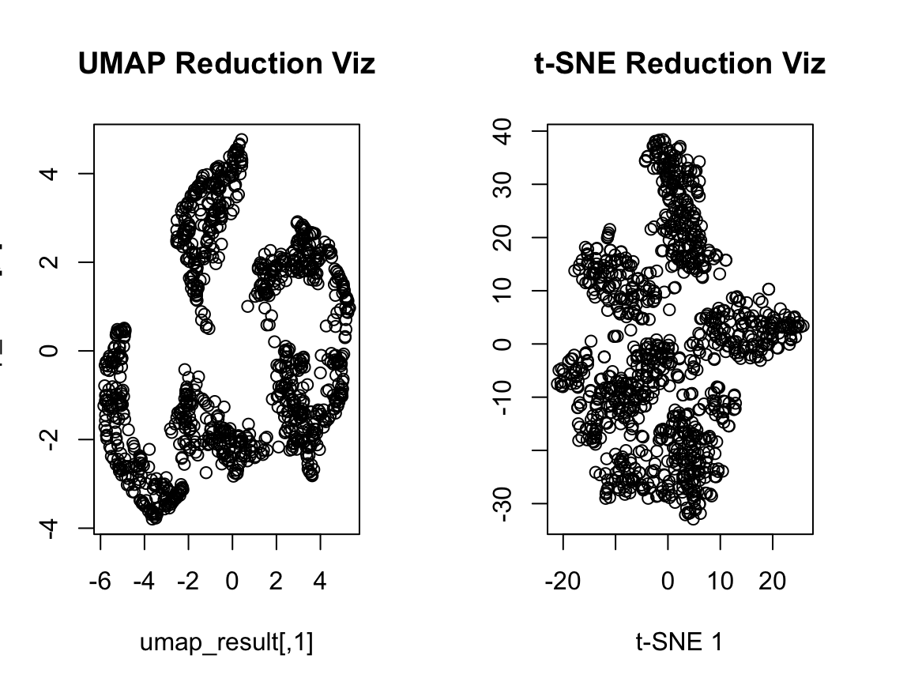
Dimensionality Reduction
PCA - Principal Component Analysis
(t-SNE) t-distributed stochastic neighbor embedding
UMAP - Uniform Manifold Approximation and Projection

Slide 11
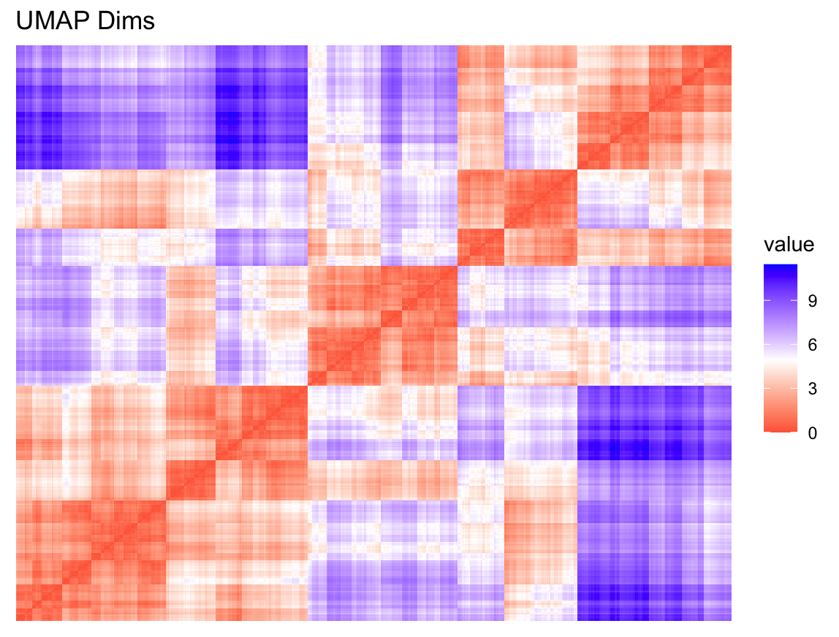
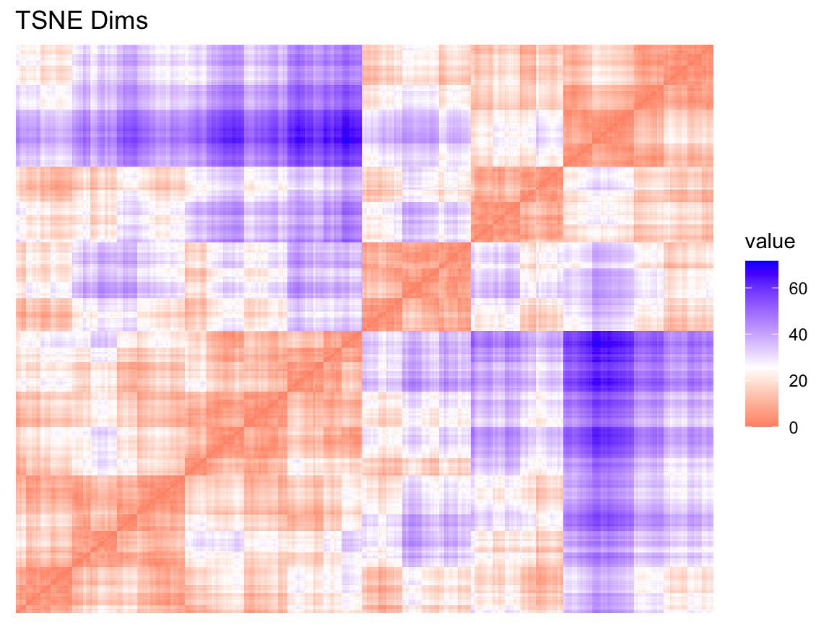
Assessing Cluster Tendency
Hopkins Statistics
TSNE: 0.9876388
UMAP: 0.9896676
Visual Methods

Slide 12
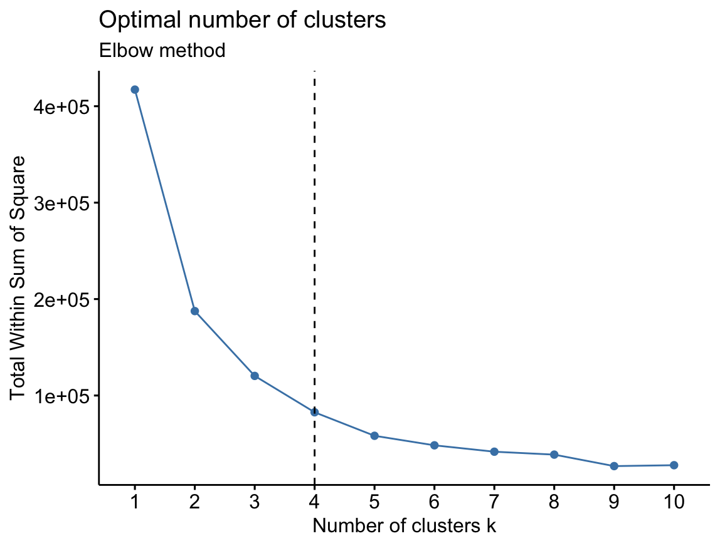
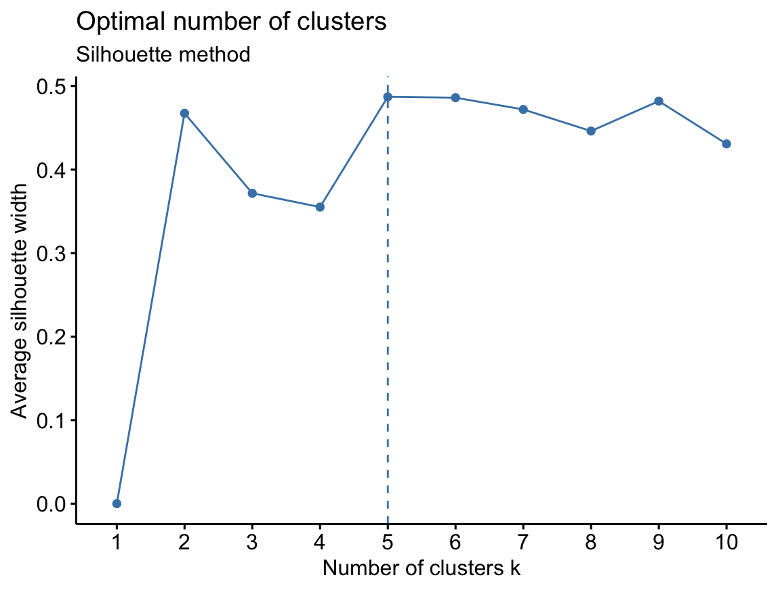
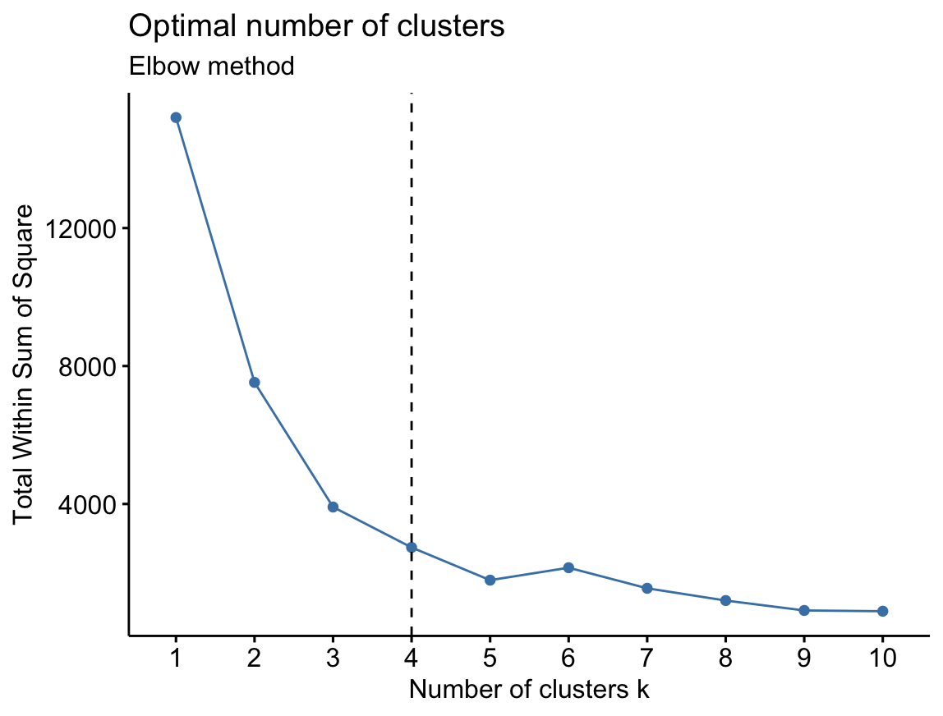
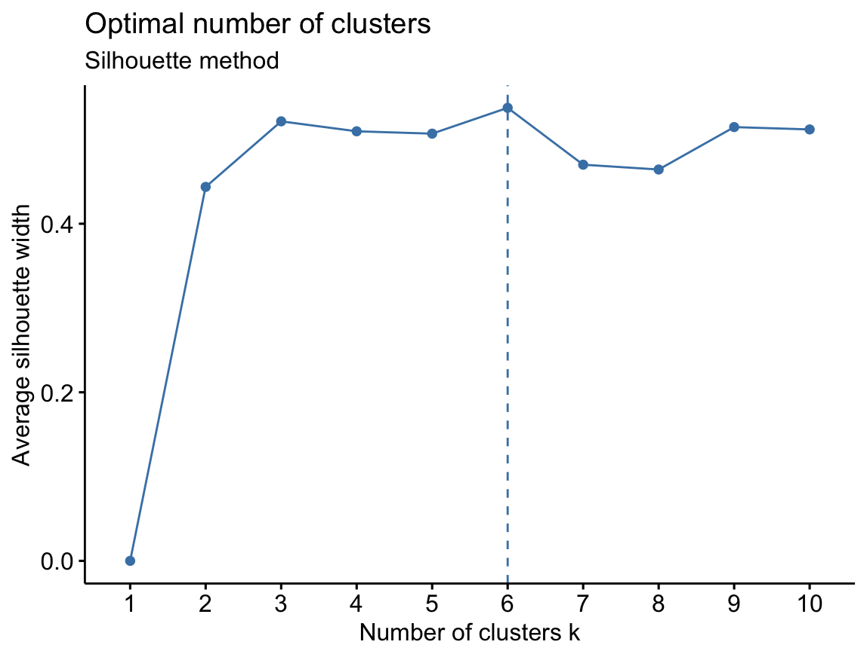
Cluster Analysis
K-Means
Elbow Method
Silhouette Method
Gap Statistic
fviz_nbclust()

Slide 13
Cluster Analysis Part 1 Summary
Algorithm | Cluster Selection Method | T-SNE Cluster sizes | UMAP cluster sizes
K-Means | Elbow | 4 | 4
 | Silhouette | 5 | 6
PAM | Elbow | 5 | 4
 | Silhouette | 4 | 6
Clara | Elbow | 4 | 4
 | Silhouette | 6 | 6
Hierarchical Clustering | Elbow | 4 | 4
 | Silhouette | 5 | 6

Slide 14
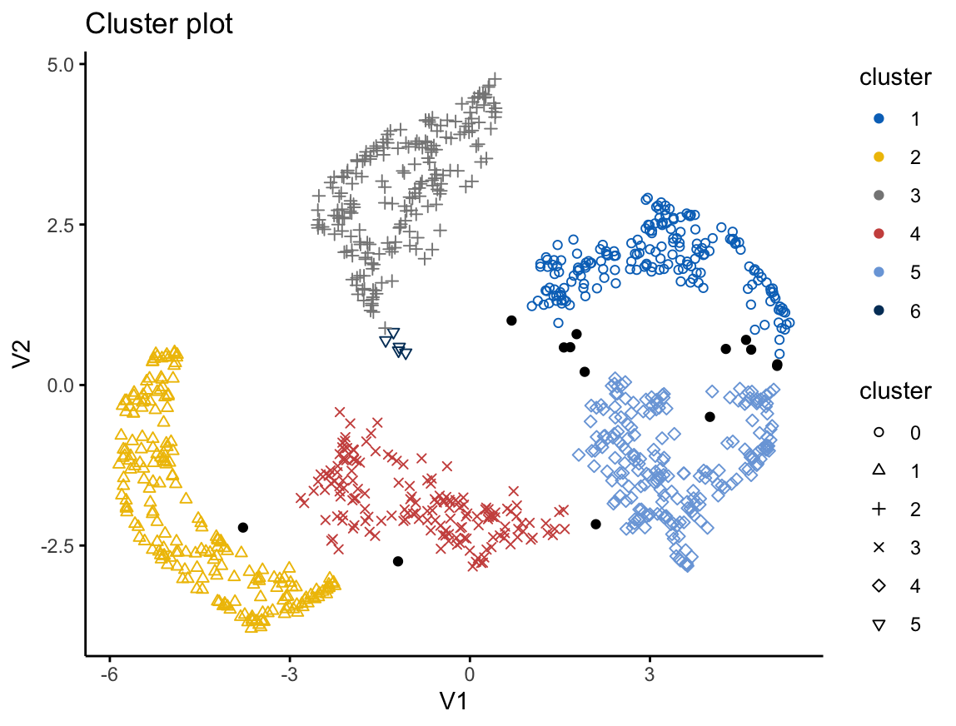
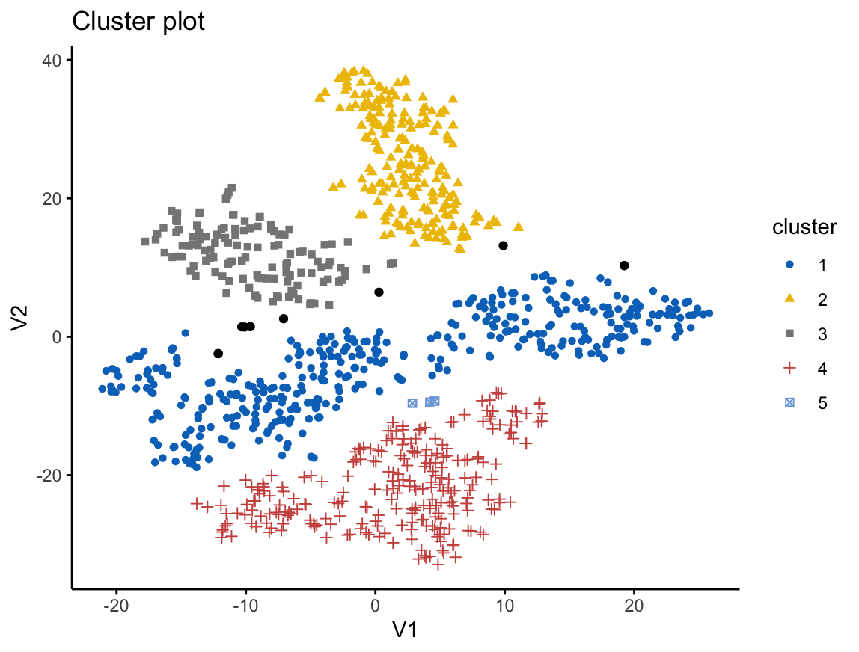
Cluster Analysis
DBSCAN - Density-based spatial clustering of applications with noise

Slide 15
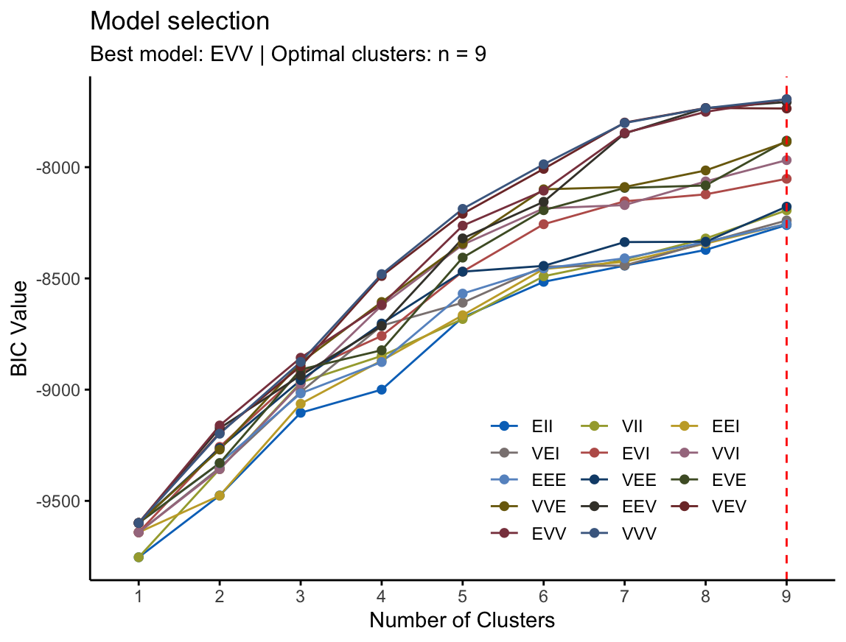
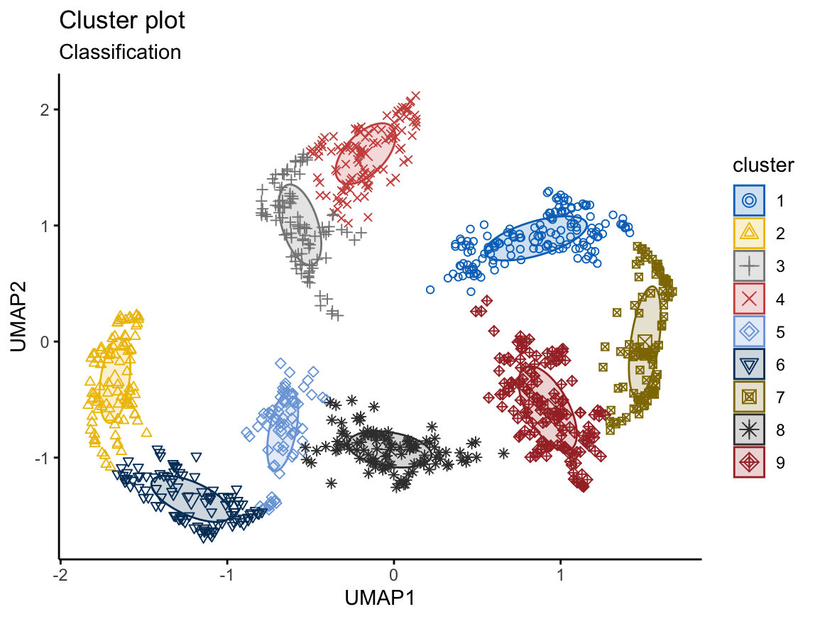
Cluster Analysis
Model-Based Clustering - Gaussian finite mixture model fitted by EM algorithm

Slide 16
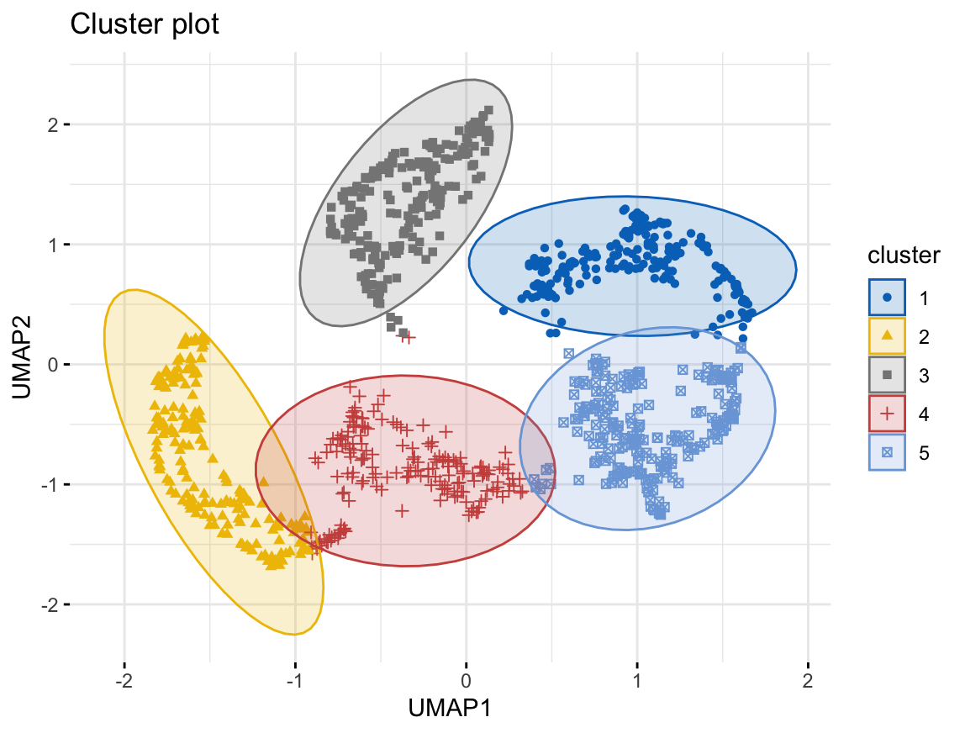
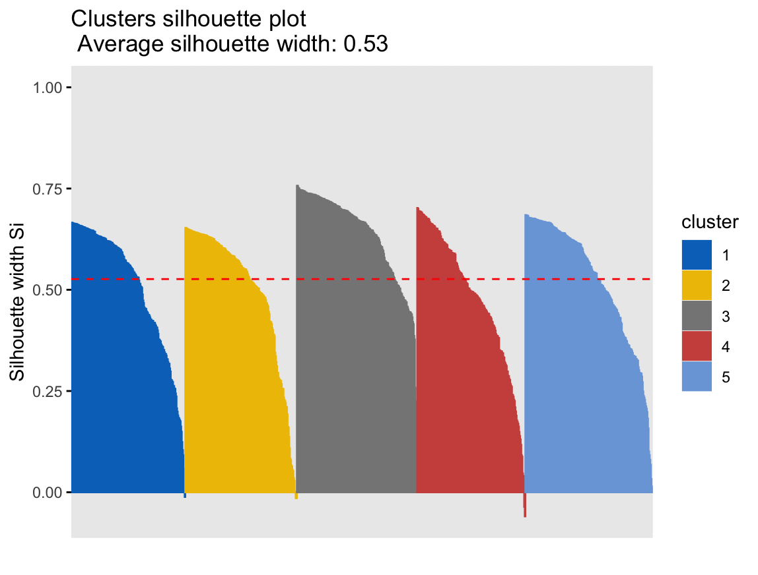
Cluster Analysis
Fuzzy Clustering

Slide 17
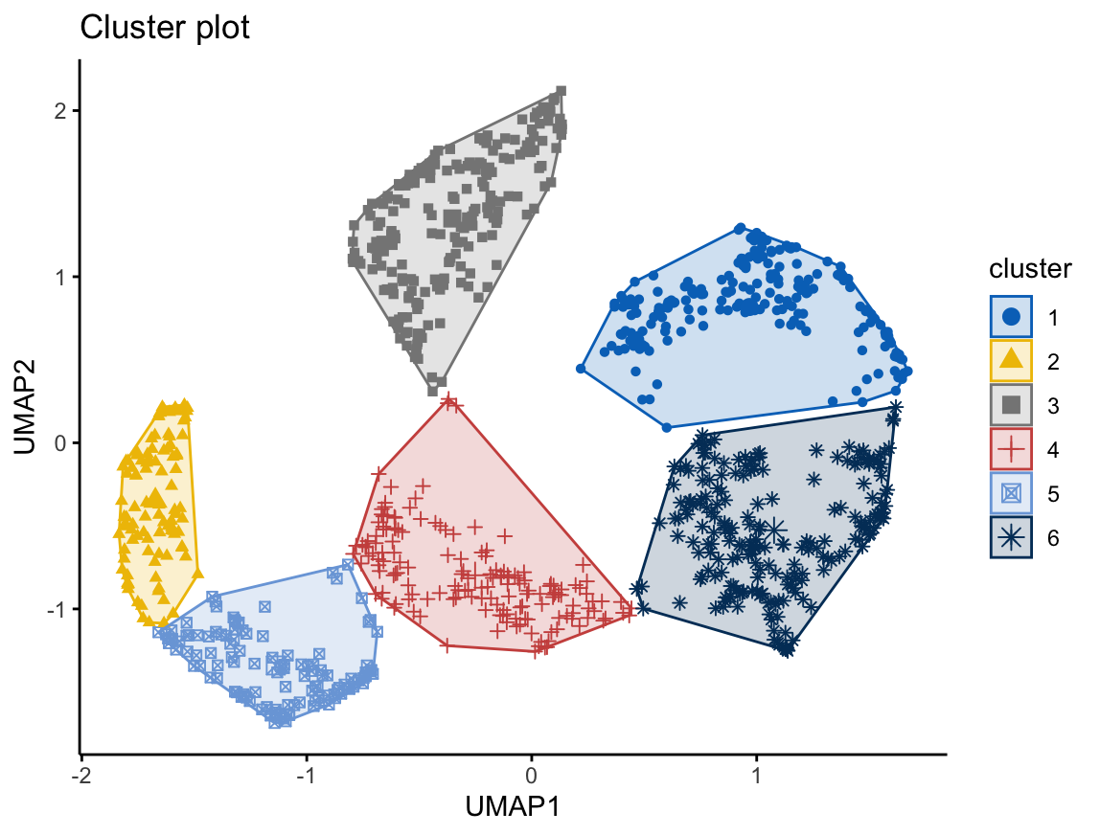
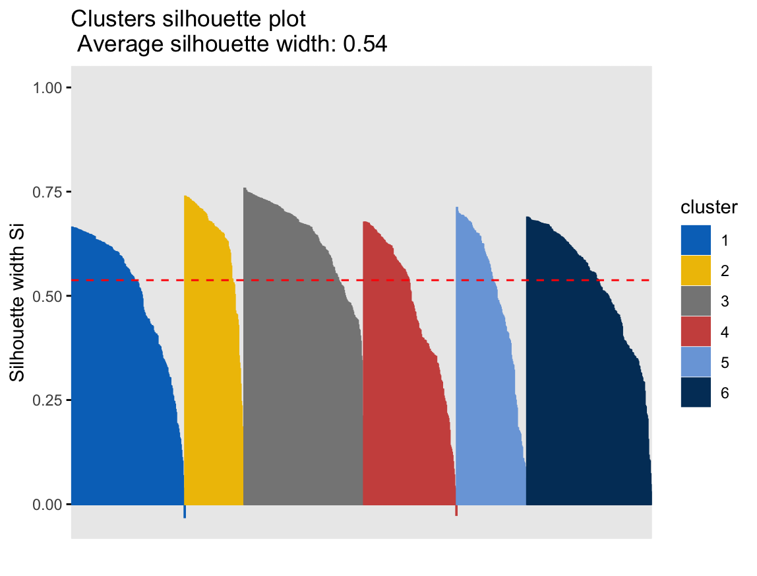
Cluster Analysis
Hierarchical K-Means Clustering

Slide 18
Cluster Analysis Part 2 Summary
For Fuzzy and Hierarchical Clustering, average silhouette width values were checked for clusters from size 4-9
Algorithm | T-SNE | Average Silhouette Width | UMAP | Average Silhouette Width
DBSCAN | 5 |  | 5
Model based Clustering | 9 |  | 9
Fuzzy | 5 | 0.53 | 5 | 0.47
Hierarchical K-Means | 5 | 0.53 | 5 | 0.49

Slide 19
Thank You!

